Slide 1
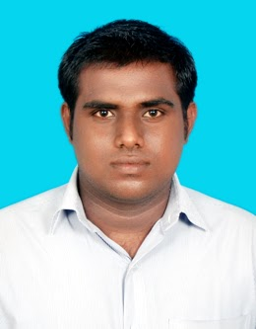
Praveen Kumar S –DevOps Engineer
Praveen Kumar has over an year experience in various DevOps tools and building CI/CD Pipeline .He is currently focusing on promoting and implementing DevOps best practices across organizations in the Insurance practice of Cognizant
Experience Snapshot
Having experience in working with below tools like
Source code management : Git , Bitbucket , TFS
Build : Ant , Maven ,Gradle
Continuous Integration : Jenkins , Bamboo
Code Coverage : Cobertura
Code Analysis : SonarQube
Testing , Containerization : Junit , Docker
S,Praveen Kumar
Key Engagements
Created a freestyle project in Jenkins which had it’s build triggered by SCM changes and able to notify the build status, Unit testing results, Code Coverage reports and SonarQube metrics for each build, via E-Mail as well as in Jenkins dashboard.
Having Knowledge on AWS areas like EC2,S3&ECS.
Academics/Certification
Bachelors in Mechanical Engineering – Anna University.
Cognizant Certified DevOps Developer
Docker Certified Associate
1

